Slide 1
Wise County Committee on Aging Programs: Home Delivered Meals (Meals on Wheels), Transportation, Group meals and Senior Activities

Slide 2
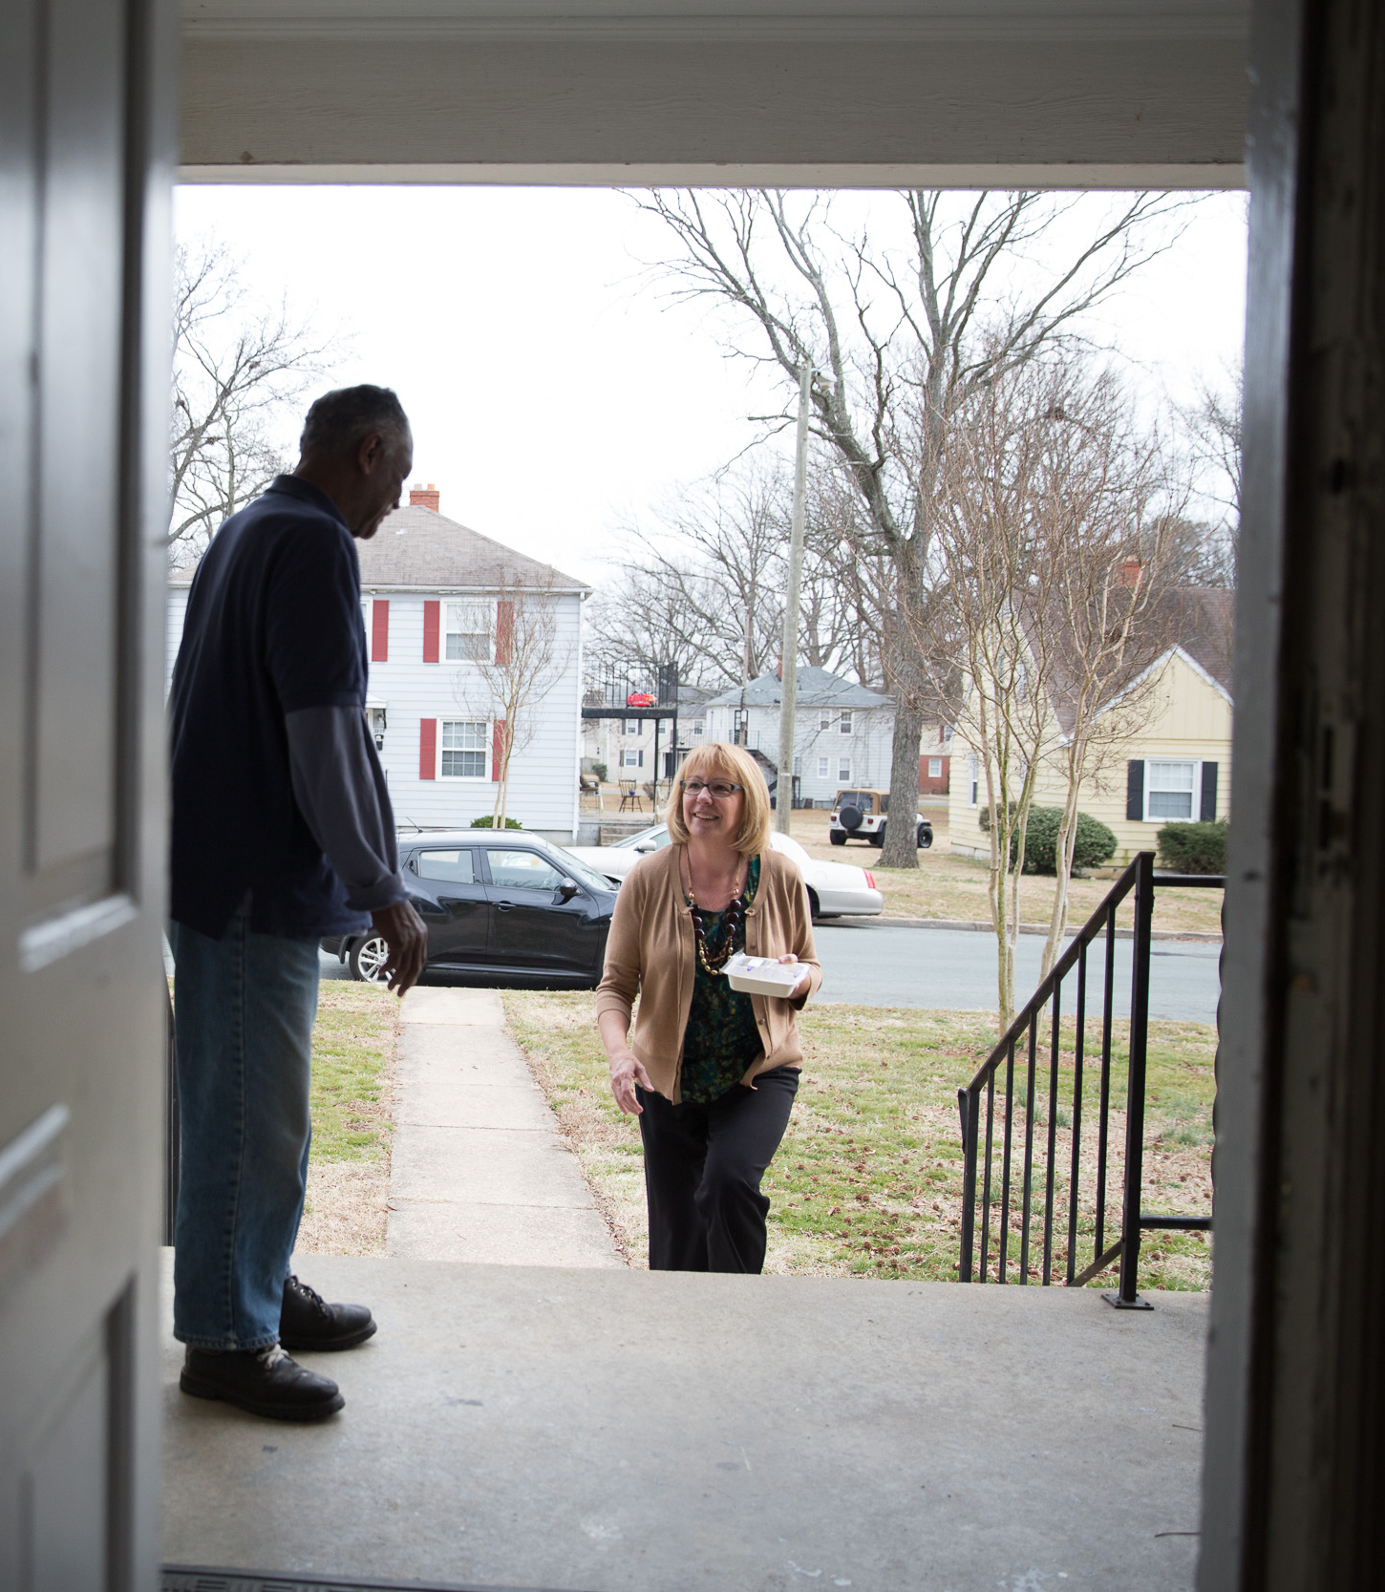
Did you know that Wise County Committee on Aging was formed in 1979 and has been serving meals daily since then? We are also a nationally recognized member of Meals on Wheels America. 10% of our clients are in Rhome and the surrounding area. Can you help us? We need financial and labor support. Currently as we do not have enough volunteers every day the 3 Rhome area routes are each done once a week. These routes can take anywhere from 1 hour to 2 hours to complete. With more volunteers this route can be done in less than 1 hour, with more volunteers these home bound seniors could be served daily.
Our clients look forward to our deliveries, for some we are the only people that they see all week long.

Slide 3
Who can be on Home Delivered Meals?
Any home bound person that is over the age of 60, that scores over a 20 on the DADS, (Dept of Aging and Disability Services ) assessment scale.
We do not charge our clients for their meals. Pre pandemic it cost about $150 a month to feed just one senior. Now that cost is over $175 and growing monthly. Even though we write grants and hold fundraisers to be able to generate the over $485,000 it cost to operate WCCA annually. Our costs are rising monthly for raw food, fuel and labor, this is a huge challenge!
Six years ago, we had less than 75 people on the HDM program and served under 20,000 meals a year. Now its at 153 HDM clients and growing and we serve over 37,800 meals annually. Plus, we have a strong congregate meal program and are serving over 190 meals a week.
We freeze over 75 meals every day for our clients that are on frozen meal routes. We also freeze weekend meals that all our home bound seniors get. So, our freezers stay rotated and full.

Slide 4
We cook our meals fresh, for daily deliveries . We also freeze some of those meals for those weekly deliveries to our clients that live farther away.
Roasting fresh chickens for over 150 meals takes time, effort, and a good stove.
Everyday volunteers come to the office in Decatur to pick up the fresh meals to be delivered around the county. Some of our volunteers deliver once a week other several times a week depending on their schedules.

Slide 5
When the weather is predicted to turn bad, that is when we are thankful for our local kitchen. This is when we shine as we are proactive in inclement weather situation. Before the last ice storm our staff and volunteers spent their Saturday cooking 6 meal plans to prepare meals in advance of the ice we were expecting in February. We like to be proactive instead of reactive when it comes to meals for our home bound seniors. We have one of the only commercial facilities in the county able to prepare emergency meals in the time of a disaster, we know that we are a vital cog in keeping our Rhome citizens and Wise County Citizens fed.

Slide 6
What it’s like to be one of our clients you’re family.
We treat our clients with respect and try to make them feel special. This was what we served for Thanksgiving Dinner in 2020, we were able to get Cornish game hens from TAFB early.
The only way we can do any of this is with Volunteers as we have multiple routes in Wise County, some covering 80 miles or more. We need more volunteers . All our routes need to be split in half due the increase in number of clients we are seeing.

Slide 7
In 2021 We served over 37,500 meals to home bound clients in Wise County
Most days we are the only person our clients ever see.
We can only do this much with donations from concerned citizens.

Slide 8
In March 2022, the Decatur Senior Center was given to WCCA. It is now open 5 days a week. We’re serving fresh meals everyday Monday through Friday to any Wise County Citizen over 60 for free. We have gone from serving about 25 meals a week at 2 congregate meal sites to serving over to over 190 a week just at the OWLS center. We are still serving meals on Thursdays at Accession/St Marks in Bridgeport. Plus, we now have a Senior food pantry with the help of TAFB. Clients from all over Wise County are coming to enjoy activities and fellowship. Two things that are greatly need within this County WCCA is providing.

Slide 9
We renamed the center to The OWLS Activity Center and added it to our list of programs.
We renamed the center to the OWLS Activity Center, so that all Wise County seniors know that they are welcome here.
Oncor donated tables, chairs and bookcases to help with the revamping. Others have been donating many other items including bingo prizes.

Slide 10
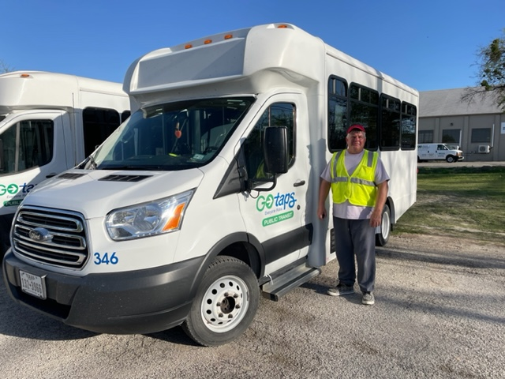
When you’re one of our clients we help schedule your rides for TAPS and pay for them via a grant from NCTCOG.

Slide 11
How can we do it all? We can’t!
We write grants and hold fundraisers to be able to generate the over $485,000 it cost to operate WCCA annually. Because of the drastic increase in food, gas, and supplies, at this point it is a struggle to met our obligation to our senior citizens.
Our budget has almost tripled in less than 6 years with the number of new seniors that have been added to the HDM program. With all the new people that are moving to Wise County the need for meals is growing faster than we can keep up with.
We suffer like all other employers now with lack of staff and no funds to pay the ever-increasing cost of new employees. Let alone give our devoted staff raises or benefits.
We hold various fundraisers annually, but it is by no means enough to keep our programs going without your help. Thanks Why I’m Here tonight.

Slide 12
Please consider putting into the 2023 Rhome budget support for WCCA
Your support of $10,000 annually will help with our growing financial needs going forward.
This will help us to keep up with the growing number of seniors in the Rhome area that need meals and other serves that WCCA provides.
As the southeast corner of the county is having the biggest grow right now, More seniors are moving in daily, and we need your help to keep up with the demand.
Right now, 30+ Seniors are waiting to get onto the home delivered meal program

